Slide 1

Prompts 1&2
Data Scientist Recruiting Work Sample
Eric Hang

Slide 2
Prompt 1:
1. Aggregate Dataset 1 at the hhld_id to create the following claim count variables:
Number of At Fault claims in each of the last 5 years from application date
Number of Not At Fault claims in each of the last 5 years from application date

Slide 3
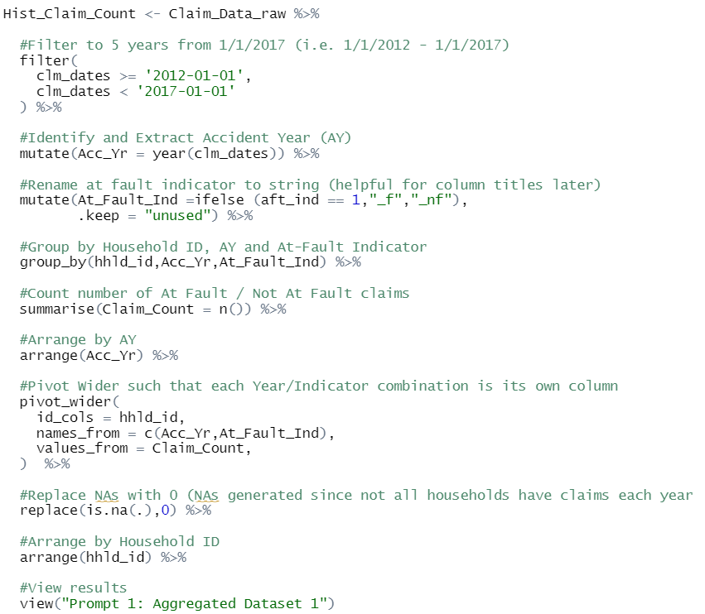
R-Code:
Filter to claim dates within 5 years of the application date (1/1/2017)
Extract Accident Year (AY) from Claim Date
Group by:
Household ID
Accident Year
At-Fault Indicator
Aggregate claim counts in each group
“Pivot Wider” to convert data from “long” to “wide” format

Slide 4
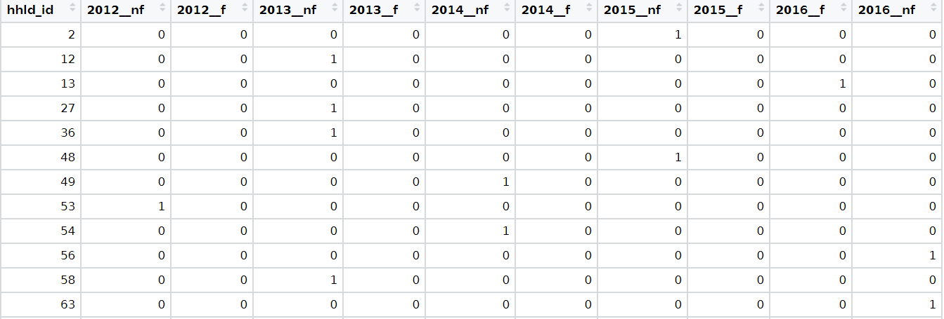
Result:
_f = At-Fault
_nf = Not At-Fault

Slide 5
Prompt 2:
Merge the Datasets 2 and 3, and the aggregated form of Dataset 1 using hhld_id

Slide 6
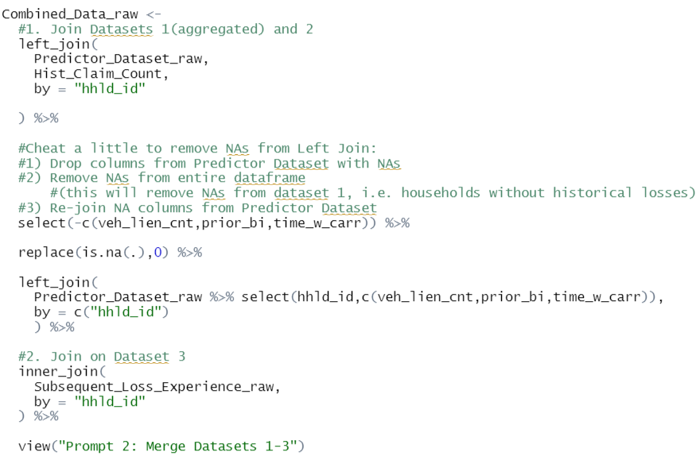
R Code:
Left Join Predictor Dataset (Dataset 2) and Historical Claim Counts (Aggregated Dataset 1) on join key “hhld_id” (Some code to remove NAs generated by left join without affecting other NAs )
Inner Join resulting data set with Subsequent Loss Experience (Dataset 3) on join key “hhld_id”

